Slide 1
PROPERTIES OF COLLOIDAL SOLUTIONS

Slide 4
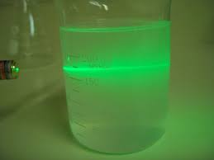

Slide 5
TYNDALL EFFECT

Slide 6
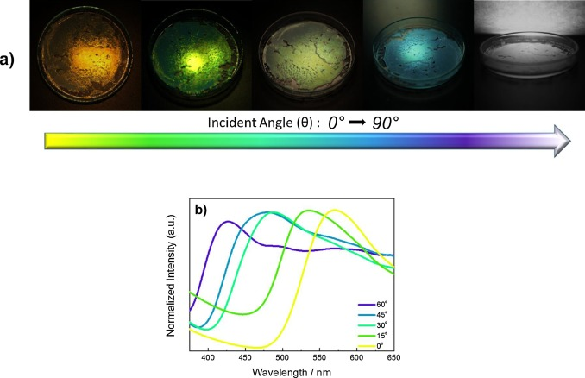
Colour of the colloid depends on wavelength of light scattered by the dispersed particles, size and nature of the dispersed particles.

Slide 7
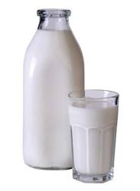
Colour of the colloid also depends on the manner in which we observe the colloid. Eg: Milk will be blue when viewed by reflected light and red when viewed by transmitted light.
Finest gold sol is red will appear purple, blue and finally golden as the size increases

Slide 10
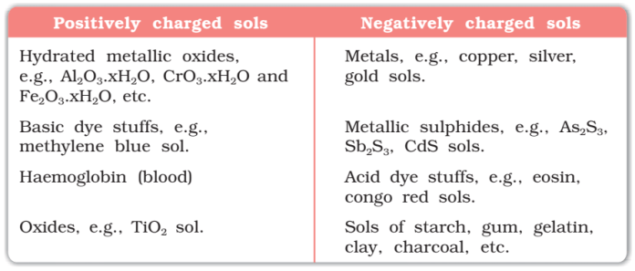

Slide 11
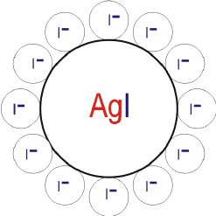

Slide 12
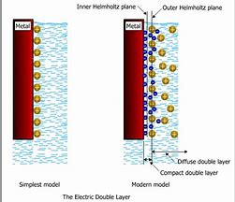
Second layer is mobile layer which termed as diffused layer while the first layer will be a stationary layer.
The potential difference between fixed layer and mobile layer of opposite charge is called electro kinetic potential or zeta potential.

Slide 14
The movement of the particle under an applied electric potential is called electrophoresis

